Slide 1

Application of the p-Median algorithm to Allocate school
Dr. Ajinkya Tanksale
Facility Location Models and Algorithms
Department Mechanical
Mahesh Purbia
Roll No : 21222004
M.Tech (1st Year)
Decision Sciences and Engineering

Slide 2
Objective :
To Propose an School-allocation model using p median algorithm considering
maximum standard distance required between students and school in context Rajasthan(India).
Why? What is the importance of such consideration (Minimum distance of Travelled.)
When Students after their basic secondary education moving to high schools, felt need of school facility located nearest to them.
2. Many parents don’t allow their daughters specifically to leave home to study in a town.
Fact : In 2011 population census literacy rate;
Rajasthan : Male = 79.2 Female = 52.1
Udaipur : Male = 74.7 Female = 48.4

Slide 3
List of Blocks of Udaipur District
All The schools in the district are divided into different blocks.
There are total 17 Blocks in the District.
This Blocks are further Divided into clusters
Source : https://schools.org.in/rajasthan/udaipur
For e.g
No of schools in the Girwa Block
Block | No. of cluster
Girwa | 46
Gogunda | 24
Mavli | 48
Jhadol | 32
Bhinder | 54
Salumber | 32
Cluster | No. of schools
G.g.u.p.s.lakad Vas Cluster | 12
G.u.p.s.aayad Cluster | 30
G.u.p.s.govardhan Vilas Gramin Cluster | 02
G.u.p.s.sec. 11 Cluster | 47
G.u.p.s.suraj Pol Tekri Cluster | 15

Slide 4
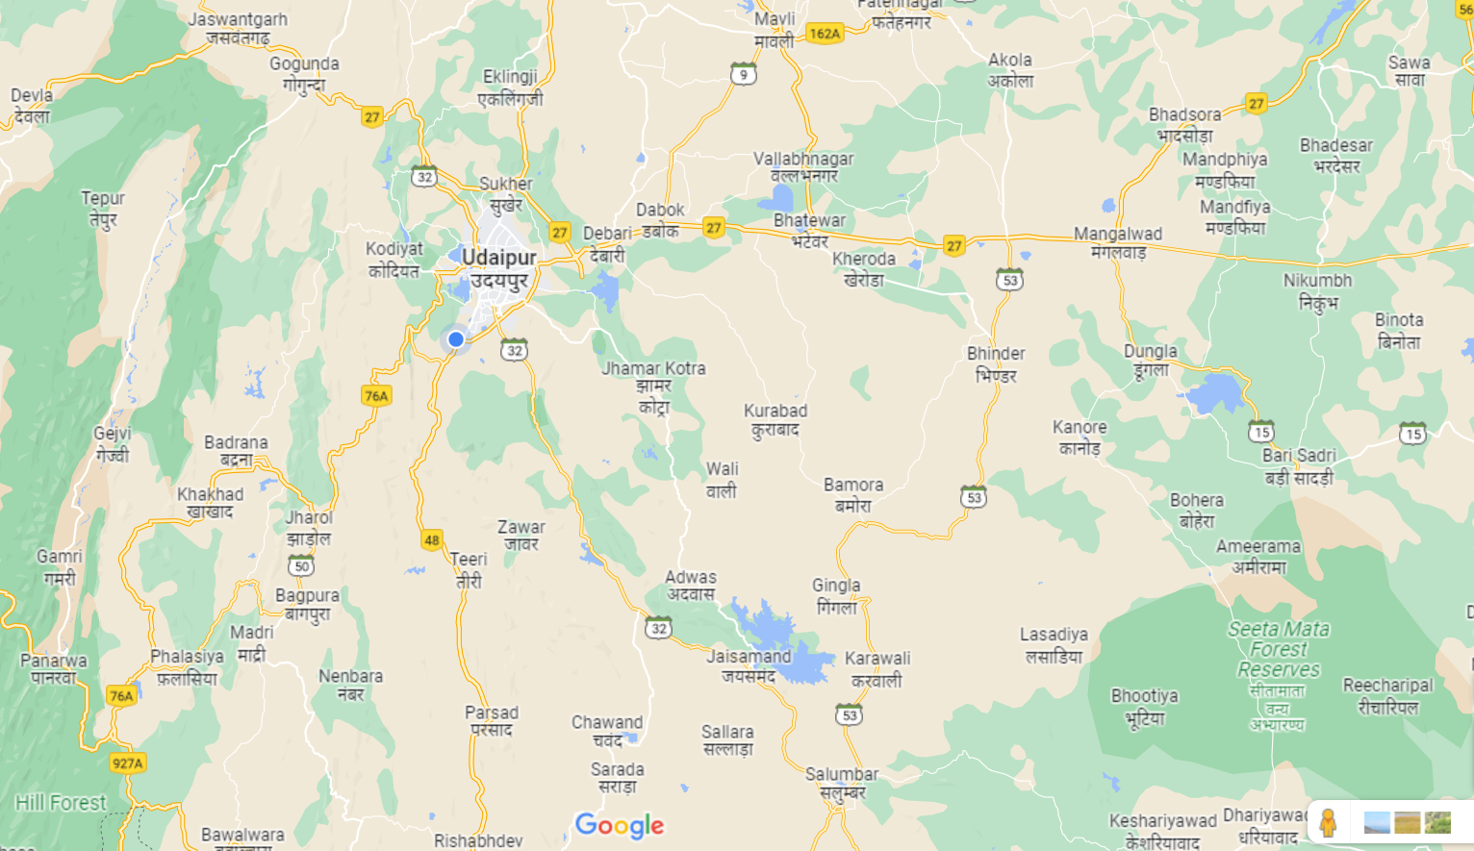







Slide 5
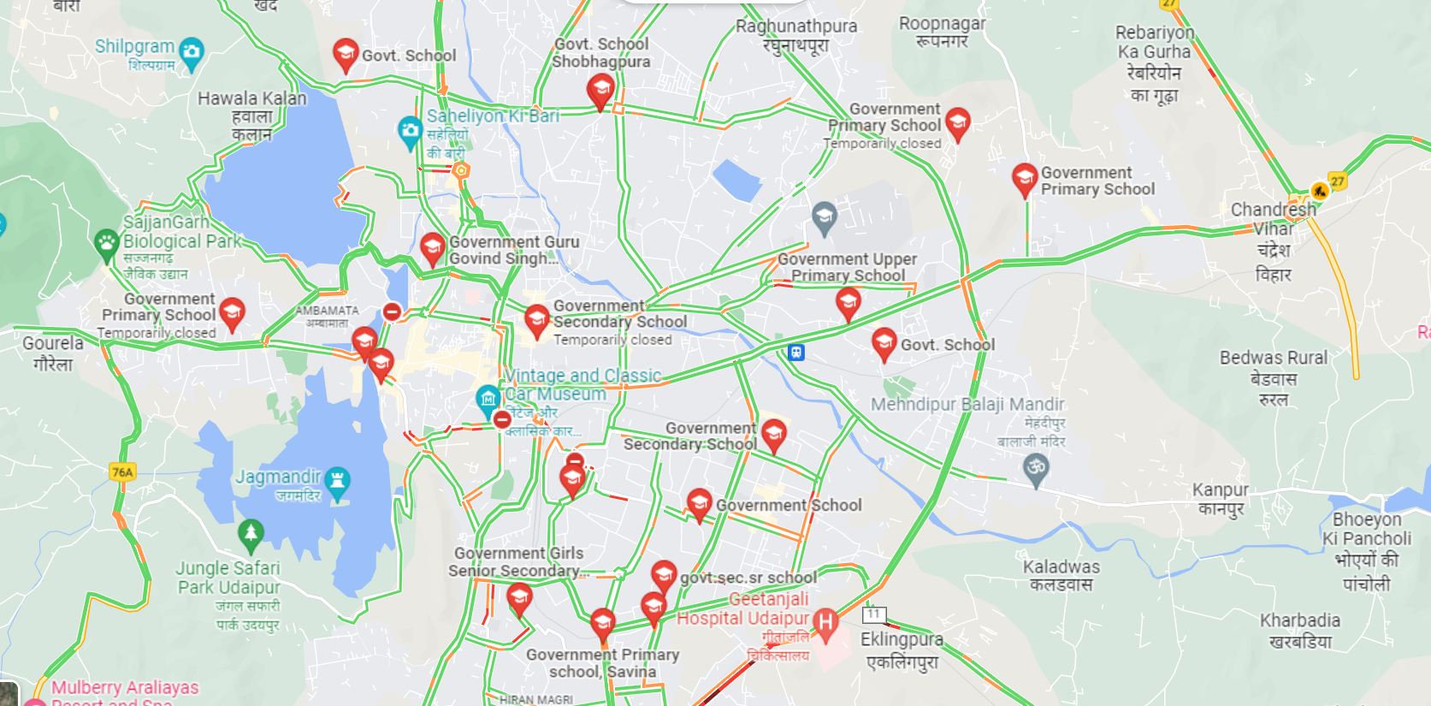
Government Schools in Udaipur Districts – Girwa Block

Slide 6
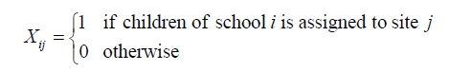
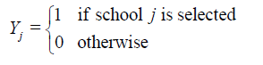
Problem Formulation
P-median model formulation for stated problem
I = 1,2,……..m demand points
J = 1,2,……..n facility locations for facilities
K = Maximum Distance to be travelled by student/pupil.
a_{i} = Population (No. of students) at the demand point i.
d_{ij} = Shortest distance between location i and location j.
p = No of school to be established.

Slide 7
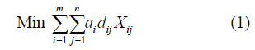
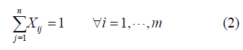
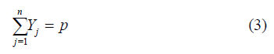
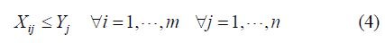
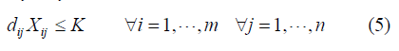
Objective function : To minimize the total weighted distance of assigning (student to facility)
Subject to :-
This Constraint ensures that each student must be assigned to atleast 1 school.
This constraint restricts the placement or allocation of facilities to exactly p, where p is the number of high schools to be established.
This constraint maintains that any such assignment must be made to only those locations that have been selected for a facility.
This Constraint imposes a maximum distance to be covered by each student.

Slide 8
The Input data to solve the stated P median problem are
Demand Points – finite no of demand point with demand values to specify the location and amount of demand that need to be satisfied
No. of facility location (p) – Position where facility can be established.
Distance – Between demand points and facility location
Population (No of students) – at demand point i
We would be considering 2 clusters of Girwa Block for our study to allocate school facility for students with minimum distance.
G.u.p.s.govardhan Vilas Gramin Cluster - 4 Schools

Slide 9
Schools in Goverdhan Villas Clusters
Considering goverdhan villas clusters has 8 Potential facility location.
Out of 8 facility location Sec 5 and Sector 14 is the available land
And the IHM and StudyKul Library have some Vacant land, where High school can be build
Table 1 : Demand Points and Zone Weights.
S.No | Schools | Zone Weight
1 | Govt. Sr.Sec school, Goverdhan villas | 290
2 | Kendriya Vidhyalay No .2 | 460
3 | Govt senior sec school - Savina | 310
4 | Govt girls Sr. Sec. School Sec 11 | 390
5 | Sector 5 (Available Land) | 01
6 | Capital Tower Sec 14 (Available Land) | 01
7 | StudyKul Library | 01
8 | Institute of Hotel Management | 01

Slide 10
Table 2 : Distance between schools and sites (Km)
 | GSS (goverdhan Villas) | KV 2 | GSS (savina) | GSS (sec 11) | Sec. 5 | Cap. Tow (Sec 14) | Studykul library | UIHM (Sec 3 )
GSS (goverdhan Villas) | 0 | 2 Km | 4 Km | 3.5 Km | 5.5 Km | 2.5 Km | 2.2 km | 6.5 km
KV 2 | 2.0 | 0 | 3.1 Km | 2.1 Km | 4.6 Km | 2.8 Km | 3.5 Km | 7.2 Km
GSS (savina) | 4.0 | 3.1 | 0 | 1.5 Km | 2.2 Km | 1.7 km | 2.8 Km | 3.5 Km
GSS (Sec11) | 3.5 | 2.1 | 1.5 | 0 | 3.6 Km | 1.5 Km | 1.2 Km | 4.8 km
Sec. 5 | 5.5 | 4.6 | 2.2 | 3.6 | 0 | 4.2 Km | 4.8 km | 1.5 Km
Cap. Tow (Sec 14) | 2.5 | 2.8 | 1.7 | 1.5 | 4.2 | 0 | 1 Km | 5.8 Km
StudyKul Library | 2.2 | 3.5 | 2.8 | 1.2 | 4.8 | 1.0 | 0 | 6.1 Km
UIHM (Sec 3) | 6.5 | 7.2 | 3.5 | 4.8 | 1.5 | 5.8 | 6.1 | 0

Slide 11
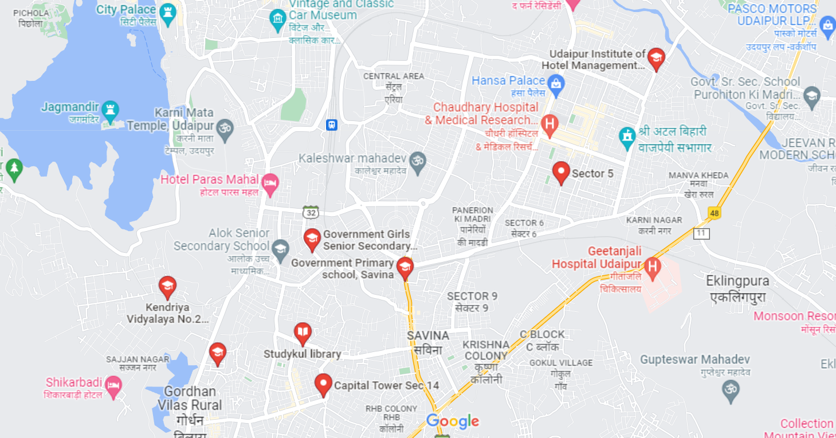








Figure : Facility location for Goverdhan Villas Cluster

Slide 12
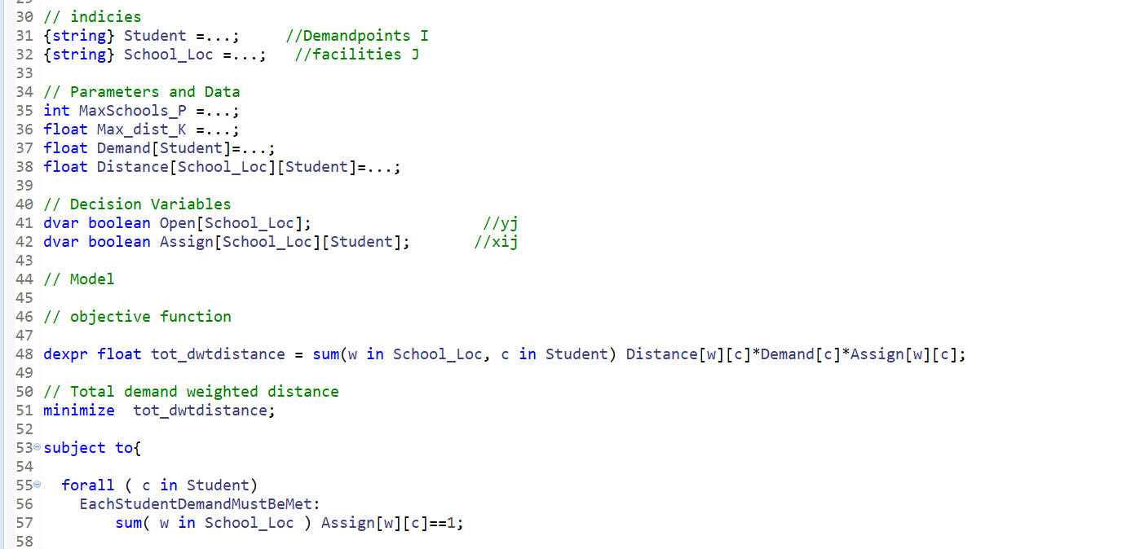
IBM-CPLEX Implementation of the problem

Slide 13
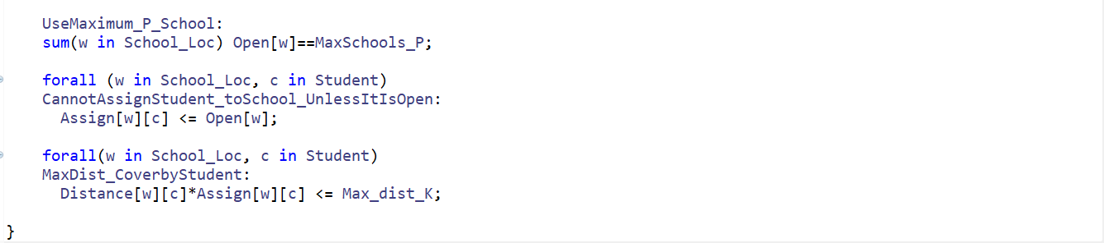
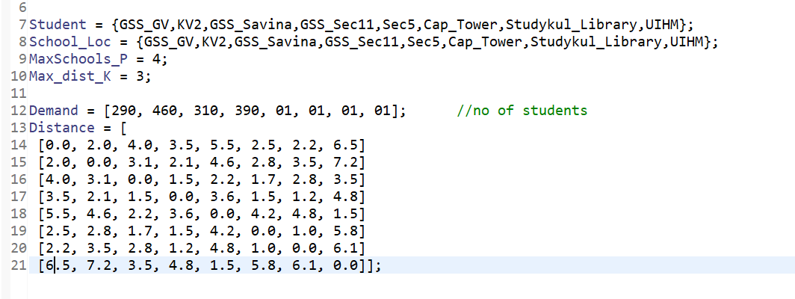
Input DATA:

Slide 14
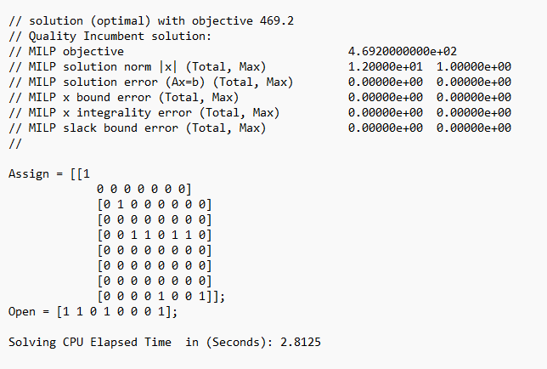

Slide 15
Result for the school location in goverdhan villas cluster of Girwa Blocks Udaipur District
All students are assigned atleast to 1 school within the maximum distance of 3 km
Location | Demand Points
GGS_GV (1) | GGS_GV
KV_2 (2) | KV_2
GSS_Sec11 (4) | GSS_Savina, GSS_Sec11,Cap_Tower,StudykulLibrary
UIHM (8) | Sec_5, UIHM

